Slide 1
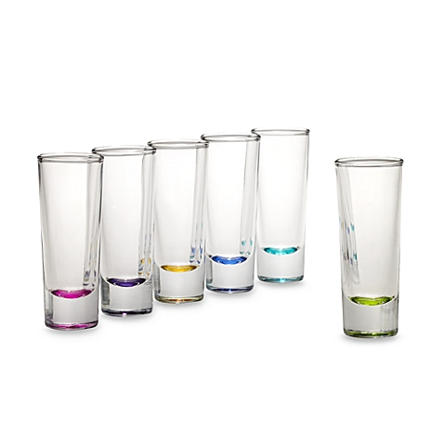
One Tap Shots

Slide 2
Introduction and Proposal
This project was proposed as a small Liquid dispensary with a LCD touch screen.
This was a project that stemmed from an idea of extending our learning if programming
and circuitry and applying it to a past time of many others. The final project is to have a LCD
screen to display possible selections to dispense at the touch of the screen and give exact amounts
Every time depending on selection. Originally an alcoholic dispenser for single or double ounce shots.

Slide 3
Budget
Raspberry Pi - $44.99 CAN
Micro SD 16GB – $9.99 CAN
5V Adaptor for Raspberry Pi - $12.99 CAN
9” LCD touch screen w/ Driver board and cables - $60US -- $75.50 CAN
Peristaltic liquid pumps x2 – $24.95 ea - $49.90 CAN
Water Sensor x 2– 6.99 ea $14US – $17.50 CAN
Estimated total $200-$220
Subtotal – $210.87
Shipping - $30 – 40
Tax ~= $30-40
Total $280
Over Budget by $60 - 80

Slide 4
Schedule
Schedule was not on time
Behind schedule by roughly 2-3 weeks
Reasons for delay
Delay of hardware parts for building of project
Missing main component (Raspberry pi)
Design of case not completed
Proto lab schedule complications
Personal time constraint complications

Slide 5
Build Video

Slide 6
Relevant Knowledge and Courses
Fundamental knowledge of Java coding
Reliance on circuitry background
Understanding of microcontroller programming
Relevant Courses
Electric Circuits
Electronic Devices and Circuits
Programming Techniques in Java
Embedded Systems
Digital and Interface Systems

